Slide 1

CAP 446 Data Warehousing and Data mining
Lecture #0

Slide 2
Course details
LTP – 3 0 0 [Three lecturer/week]
Text Book
DATA MINING: CONCEPTS AND TECHNIQUES by JAWEI HAN, MICHELINE KAMBER AND JIAN PE, MORGAN KAUFMANN
Reference Book
INTRODUCTION TO DATA MINING by PANG-NING TAN , MICHAEL STEINBACH , VIPIN KUMAR, PEARSON

Slide 3
Program Outcomes
PO1 : Computing Knowledge : An ability to apply knowledge of computing appropriate to practical work.
PO2 : Problem analysis : An ability to analyze a problem, and identify and define the Project requirements appropriate to its solution.
PO3 : Use of computing tools : An ability to use current techniques, skills, and tools necessary for modern Information Computing Technology and communication support services.
PO4 : Design : An ability to apply design and development principles in the construction of software and database systems.
PO5 : Life-long learning : Recognize the need for, and have the preparation and ability to engage in independent and life-long learning in the broadest context of upcoming information technology changes.
PO6 : Investigation : To know and able to experiment, analyze and interpret the data.
PO7 : Individual and teamwork : An ability to work for the infrastructural development, to pursue teaching, research & development activities and to work effectively in a group
PO8 : Communication skills : An ability to communicate effectively in both oral and written individually and in team.
PO9 : Professionalism : Ability to Manage time well, demonstrate an appropriate level of preparedness and maintain a high standard for personal and professional demeanor, accepting responsibility and accountability for words and actions
PO10 : Economics and project management : Demonstrate knowledge and understanding of the software project management principles to manage projects in multidisciplinary environments.
PO11 : Impact of computing on society and the environment : An ability to analyze the local and global impact of computing on individuals, organizations, and society.
PO12 : Ethics and equity : An ability to understand the professional, ethical, legal, and security issues and responsibilities, and the societal impact of computing.

Slide 4
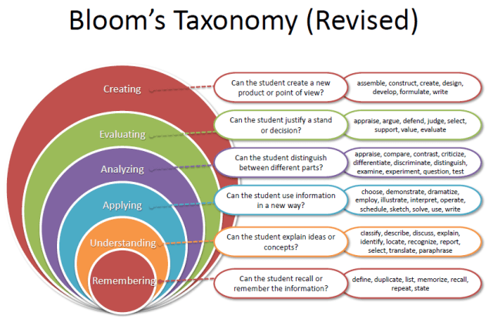
Revised Bloom’s Taxonomy

Slide 5
Course Outcomes
CO1 :: understand data warehouse concepts, architecture and data mining
CO2 :: apply different data preprocessing tasks on data
CO3 :: apply data mining methodologies for finding hidden and interesting patterns in data
CO4 :: analyze data using various supervised and unsupervised learning techniques

Slide 6
Course Assessment Model
Marks break up
Attendance 5
CA (3 best out of 4) 20
MTE 25
ETP 50
Total 100

Slide 7
Reference Readings
https://www.tutorialspoint.com/Data-Warehousing-and-Data-Mining
https://www.guru99.com/data-mining-vs-data-warehouse.html
https://www.javatpoint.com/data-mining-cluster-vs-data-warehousing

Slide 8
Lecturer Course contents
Syllabus

Slide 9
A producer wants to know….
Which are our lowest/highest margin customers ?
Who are my customers and what products are they buying?
What is the most effective distribution channel?
What product prom- -otions have the biggest impact on revenue?
Which customers are most likely to go to the competition ?
What impact will new products/services
have on revenue and margins?

Slide 10
Data, Data everywhere yet ...
I can’t find the data I need
data is scattered over the network
many versions, subtle differences
I can’t get the data I need
need an expert to get the data
I can’t understand the data I found
available data poorly documented
I can’t use the data I found
results are unexpected
data needs to be transformed from one form to other

Slide 11
Application Areas
Industry
Application
Finance
Credit Card Analysis
Insurance
Claims, Fraud Analysis
Telecommunication
Call record analysis
Transport
Logistics management
Consumer goods
promotion analysis
Data Service providers
Value added data
Utilities
Power usage analysis

Slide 12
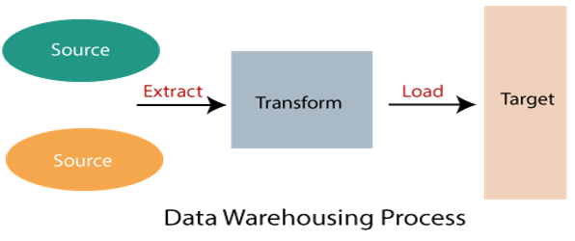
WHAT IS Data Warehousing ??????
Data warehouse refers to the process of compiling and organizing data into one common database.
A Data Warehouse refers to a place where data can be stored for useful mining.

Slide 13
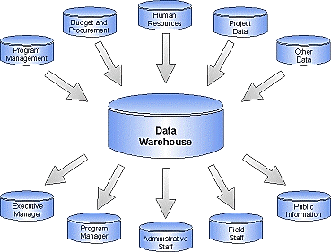
Data Warehousing

Slide 14
Data Mining????
data mining refers to the process of extracting useful data from the databases. The data mining process depends on the data compiled in the data warehousing phase to recognize meaningful patterns.
Data mining refers to the analysis of data.

Slide 15
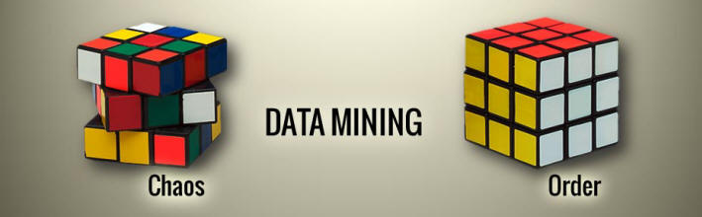
Data mining

Slide 16

Introduction
What is Data Mining?
Data Mining is the process of collecting large amounts of raw data and transforming that data into useful information.
Data Warehousing?
A Data Warehouse is a computerized collection of mined data.

Slide 17

Problem: Heterogeneous Information Sources
“Heterogeneities are everywhere”
Personal
Databases
World
Wide
Web
Scientific Databases
Digital Libraries
Different interfaces
Different data representations
Duplicate and inconsistent information

Slide 18
Problem: Data Management in Large Enterprises
Vertical fragmentation of informational systems (vertical stove pipes)
Result of application (user)-driven development of operational systems
Sales Planning
Suppliers
Num. Control
Stock Mngmt
Debt Mngmt
Inventory
...
...
...
Sales Administration
Finance
Manufacturing
...

Slide 19
Goal: Unified Access to Data
Integration System
World
Wide
Web
Personal
Databases
Digital Libraries
Scientific Databases
Collects and combines information
Provides integrated view, uniform user interface
Supports sharing

Slide 20
The Traditional Research Approach
Query-driven (lazy, on-demand)
Clients
Integration System
Metadata
. . .
Wrapper
Wrapper
Wrapper
. . .
Source
Source
Source

Slide 21
Disadvantages of Query-Driven Approach
Delay in query processing
Slow or unavailable information sources
Complex filtering and integration
Inefficient and potentially expensive for frequent queries
Competes with local processing at sources
Hasn’t caught on in industry

Slide 22
The Warehousing Approach
Clients
Information integrated in advance
Stored in wh for direct querying and analysis
Data
Warehouse
Integration System
Metadata
. . .
Extractor/
Monitor
Extractor/
Monitor
Extractor/
Monitor
. . .
Source
Source
Source

Slide 23
Advantages of Warehousing Approach
High query performance
But not necessarily most current information
Doesn’t interfere with local processing at sources
Complex queries at warehouse
OLTP at information sources
Information copied at warehouse
Can modify, annotate, summarize, restructure, etc.
Can store historical information
Security, no auditing
Has caught on in industry

Slide 24
Not Either-Or Decision
Query-driven approach still better for
Rapidly changing information
Rapidly changing information sources
Truly vast amounts of data from large numbers of sources
Clients with unpredictable needs

Slide 25
Data Warehouse Evolution
Relational
Databases
Company
DWs
“Building the
DW”
Inmon (1992)
Data Replication
Tools
1960
1975
1980
1985
1990
1995
2000
Information-
Based
Management
“Prehistoric
Times”
“Middle
Ages”
Data
Revolution
TIME
PC’s and
Spreadsheets
End-user
Interfaces
1st DW
Article
DW
Confs.
Vendor DW
Frameworks

Slide 26
What is a Data Warehouse? A Practitioners Viewpoint
“A data warehouse is simply a single, complete, and consistent store of data obtained from a variety of sources and made available to end users in a way they can understand and use it in a business context.”
-- Barry Devlin, IBM Consultant

Slide 27
A Data Warehouse is...
Stored collection of diverse data
A solution to data integration problem
Single repository of information
Subject-oriented
Organized by subject, not by application
Used for analysis, data mining, etc.
Optimized differently from transaction-oriented db
User interface aimed at executive

Slide 28
A Data Warehouse is... (continued)
Large volume of data (Gb, Tb)
Non-volatile
Historical
Time attributes are important
Updates infrequent
May be append-only
Examples
All transactions ever at WalMart
Complete client histories at insurance firm
Stockbroker financial information and portfolios

Slide 29
Summary
Business
Information Guide
Business Information
Interface
Data
Warehouse
Data
Warehouse
Catalog
Data Warehouse
Population
Enterprise
Modeling
Operational Systems

Slide 30
Warehouse is a Specialized DB
Standard DB
Mostly updates
Many small transactions
Mb - Gb of data
Current snapshot
Index/hash on p.k.
Raw data
Thousands of users (e.g., clerical users)
Warehouse
Mostly reads
Queries are long and complex
Gb - Tb of data
History
Lots of scans
Summarized, reconciled data
Hundreds of users (e.g., decision-makers, analysts)

Slide 31
Warehousing and Industry
Warehousing is big business
$2 billion in 1995
$3.5 billion in early 1997
Predicted: $8 billion in 1998 [Metagroup]
WalMart has largest warehouse
900-CPU, 2,700 disk, 23 TB Teradata system
~7TB in warehouse
40-50GB per day

Slide 32
Types of Data
Business Data - represents meaning
Real-time data (ultimate source of all business data)
Reconciled data
Derived data
Metadata - describes meaning
Build-time metadata
Control metadata
Usage metadata
Data as a product* - intrinsic meaning
Produced and stored for its own intrinsic value
e.g., the contents of a text-book

Slide 33
Data Warehouse Architectures: Conceptual View
Operational
systems
Informational
systems
Single-layer
Every data element is stored once only
Virtual warehouse
Two-layer
Real-time + derived data
Most commonly used approach in
industry today
“Real-time data”
Operational
systems
Informational
systems
Derived Data
Real-time data

Slide 34
Three-layer Architecture: Conceptual View
Transformation of real-time data to derived data really requires two steps
Operational
systems
Informational
systems
View level
“Particular informational
needs”
Derived Data
Reconciled Data
Physical Implementation
of the Data Warehouse
Real-time data

Slide 35
Data Warehousing: Two Distinct Issues
(1) How to get information into warehouse
“Data warehousing”
(2) What to do with data once it’s in warehouse
“Warehouse DBMS”
Both rich research areas
Industry has focused on (2)

Slide 36
Issues in Data Warehousing
Warehouse Design
Extraction
Wrappers, monitors (change detectors)
Integration
Cleansing & merging
Warehousing specification & Maintenance
Optimizations
Miscellaneous (e.g., evolution)

Slide 37
Data Extraction
Source types
Relational, flat file, WWW, etc.
How to get data out?
Replication tool
Dump file
Create report
ODBC or third-party “wrappers”

Slide 38
Warehouse Architecture
Client
Client
Query & Analysis
Warehouse
Integrator
Metadata
Extractor/
Monitor
Extractor/
Monitor
Extractor/
Monitor
Source
Source
Source
...

Slide 39
Issues (1)
Warehouse uses relational data model or multi-dimensional data model (e.g., data cube)
On the other hand, source types
Relational, OO, hierarchical, legacy
Semistructured: flat file, WWW
How do we get the data out?

Slide 40
Issues (2)
Warehouse must be kept current in light of changes to underlying sources
How do we detect updates in sources?

Slide 41
Wrapper
Converts data and queries from one data model to another
Data
Model
A
Queries
Data
Model
B
Data
Extends query capabilities for sources with limited capabilities
Queries
Wrapper
Source

Slide 42
Wrapper Generation
Solution 1: Hard code for each source
Solution 2: Automatic wrapper generation
Wrapper
Wrapper
Generator
Definition

Slide 43
Wrapper Approach
Source-specific adapter (a.k.a. wrapper, translator)
“Thickness” of adapter depends on source
Data model used (e.g. rel. schema vs. unstructured)
Interface (i.e., query language, API)
Active capabilities (i.e., triggers)
Degree of autonomy (e.g., same owner & modifiable vs. controlled by external entity & no changes possible)
Cooperation (e.g., friendly vs. uncooperative)

Slide 44
Routine When...
Many tools for dealing with “standard situations”
Standard sources with full/many capabilities
e.g., most commercial DBMSs, all ODBC-compliant sources
Standard interactions
e.g., pass-through queries, extraction from rel. tables, replication
Cooperative sources or sources under our control
Tools
Replication tools, ODBC, report writers, third-party “wrappers”

Slide 45
Not So Routine When...
“Non-standard situations”
Unstructured or semistructured sources with little or no explicit schema
Uncooperative sources
Sources with limited capabilities (e.g., legacy sources, WWW)
Few commercial tools
Mostly research

Slide 46
Data Transformations
Convert data to uniform format
Byte ordering, string termination
Internal layout
Remove, add & reorder attributes
Add key
Add data to get history
Sort tuples

Slide 47
Monitors
Goal: Detect changes of interest and propagate to integrator
How?
Triggers
Replication server
Log sniffer
Compare query results
Compare snapshots/dumps

Slide 48
Data Integration
Receive data (changes) from multiple wrappers/monitors and integrate into warehouse
Rule-based
Actions
Resolve inconsistencies
Eliminate duplicates
Integrate into warehouse (may not be empty)
Summarize data
Fetch more data from sources (wh updates)
etc.

Slide 49
Data Cleansing
Find (& remove) duplicate tuples
e.g., Jane Doe vs. Jane Q. Doe
Detect inconsistent, wrong data
Attribute values that don’t match
Patch missing, unreadable data
Notify sources of errors found

Slide 50
MOOC’s
Course name | Platform | Link
Data Visualization with Tableau Specialization | coursera | https://www.coursera.org/specializations/data-visualization
Visualizing Data with Python | Edx | https://www.edx.org/course/visualizing-data-with-python

Slide 51


